Slide 1



BOOK RECOMMENDATION WEBSITE
PROJECT MEMBER:
SARAN C S (22EIR072)
SIVARAJ S (22EIR081)
SOWMIYA S(22EIR085)

Slide 2
PROBLEM STATEMENT
Develop a BOOK RECOMMENDATION WEBSITE that enables users to efficiently search and helps to discover new books to read.

Slide 3
PROJECT DESCRIPTION
This project presents the development of a full-stack book recommendation website, showcasing technologies for user authentication, personalized recommendations, and community reviews.
In this website development, we use MERN stack to develop this book recommendation website.

Slide 4
OBJECTIVE
Allow users to create profiles and save preferences for personalized experiences.
creating a recommendation engine that suggests books based on user preferences.
Utilize data to suggest personalized book options based on user behavior.

Slide 5
MODULE DESCRIPTION
User Management
Facilitate account creation with a username, email, and password.
Support login and signup features.
Grant access to both Admin and User roles.
Book Management Module
Manage book details (add, edit, delete, view).
Implement search and filtering options by criteria, and monitor real-time availability.

Slide 6
FLOW CHART
START
SUBSCRIBER
SIGN UP
SIGIN IN
HOME PAGE
TOP TRENDING BOOKS
CONTACT ADMIN

Slide 7
TECHNOLOGY USED
Front-End:
Html5
Css
Javascript
Back-End & Database:
MongoDB
Nodejs
Reactjs

Slide 8
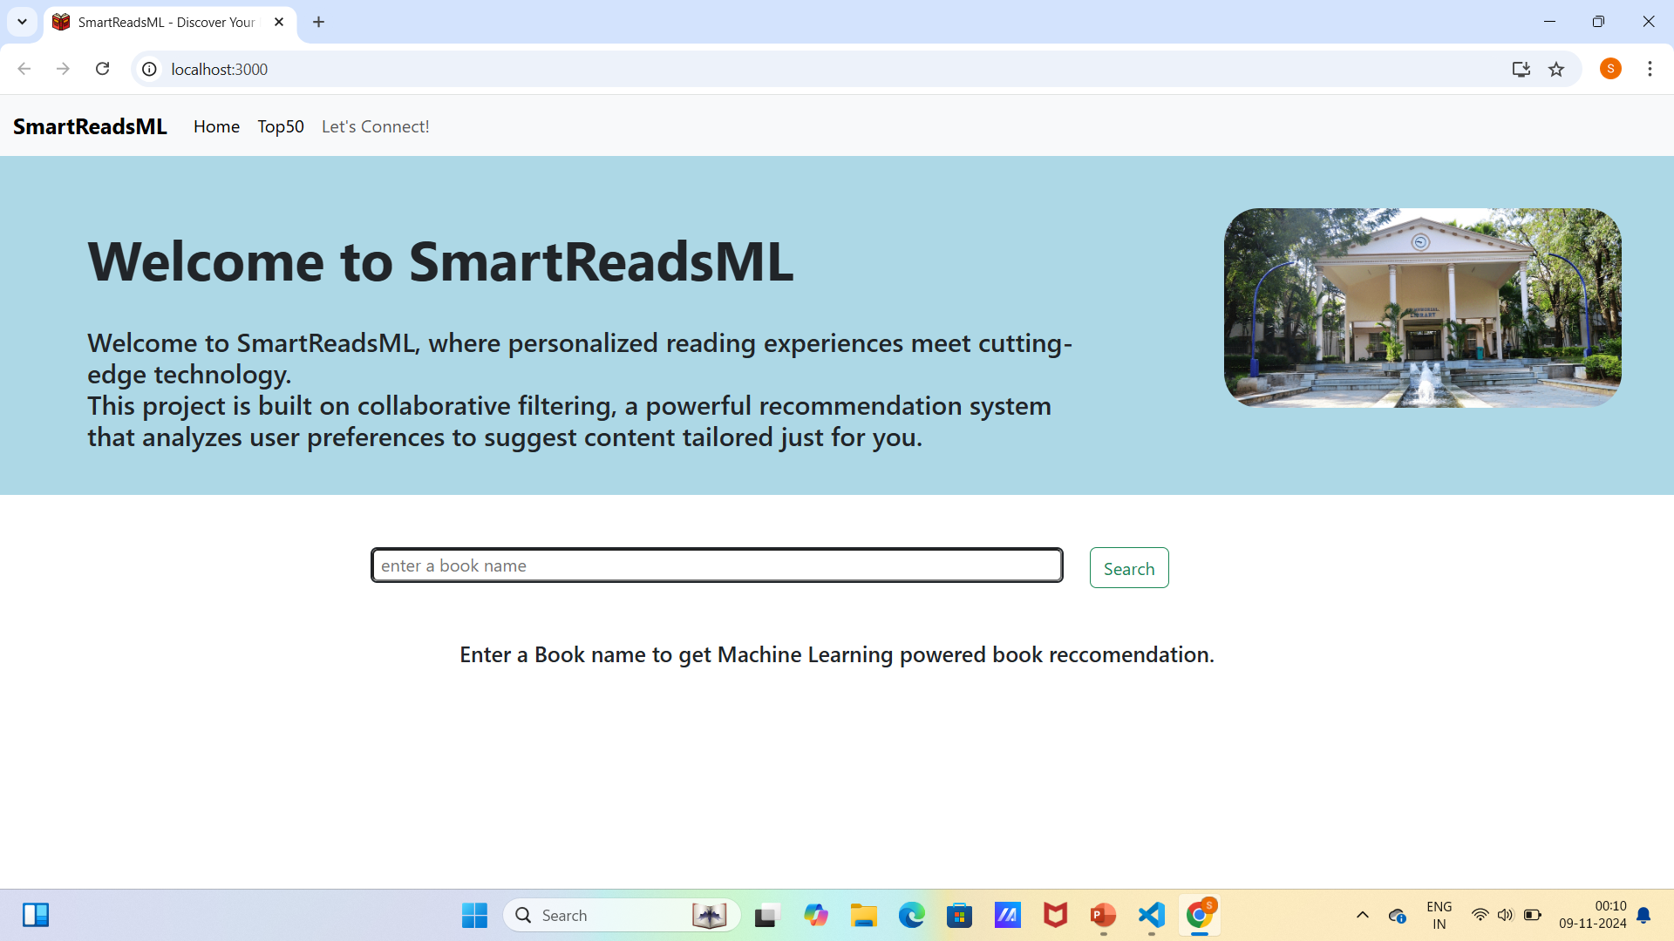
FRONT PAGE

Slide 9
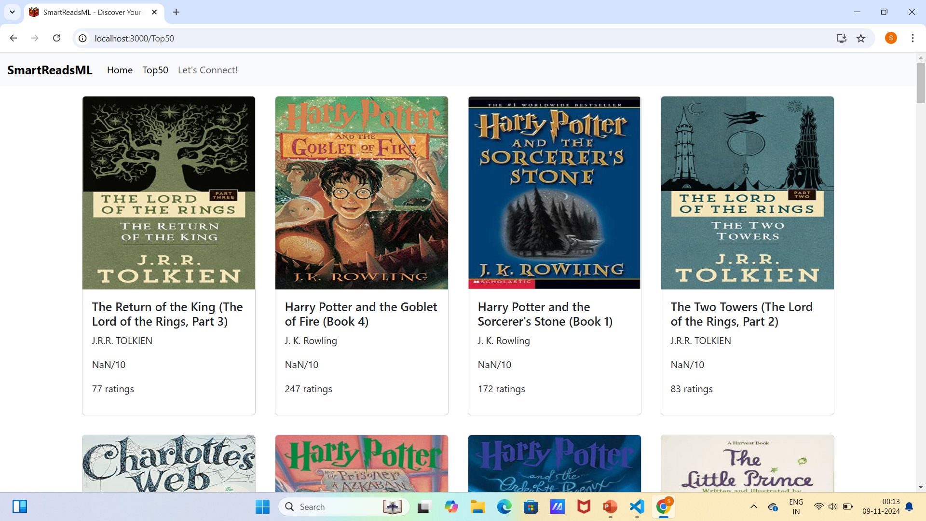
TRENDING BOOKS

Slide 10
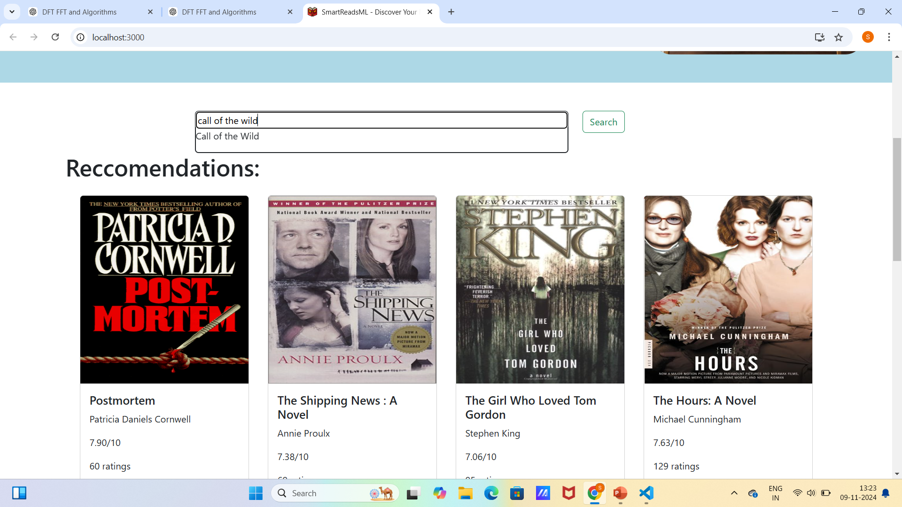
Book Recommendations Based on Your Interest

Slide 11
Future Work / Next Steps
Create sign up and log in page
Gather feedback and make necessary updates.
Mention potential features like improving recommendation accuracy, adding more data sources, or including user reviews.
Website can be developed into mobile application

Slide 12
THANK YOU

